Slide 1
HUD & PHAs Serving Wisconsin Together
2021 Fall WAHA Conference

Slide 2
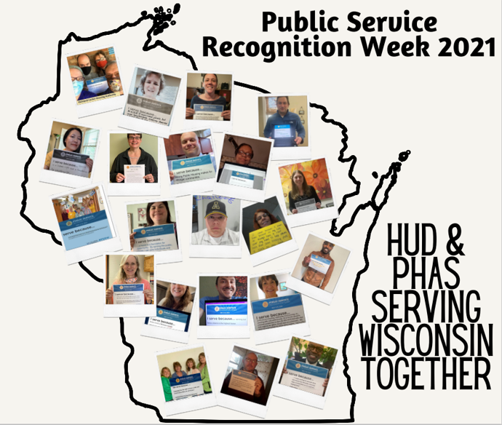

Slide 3
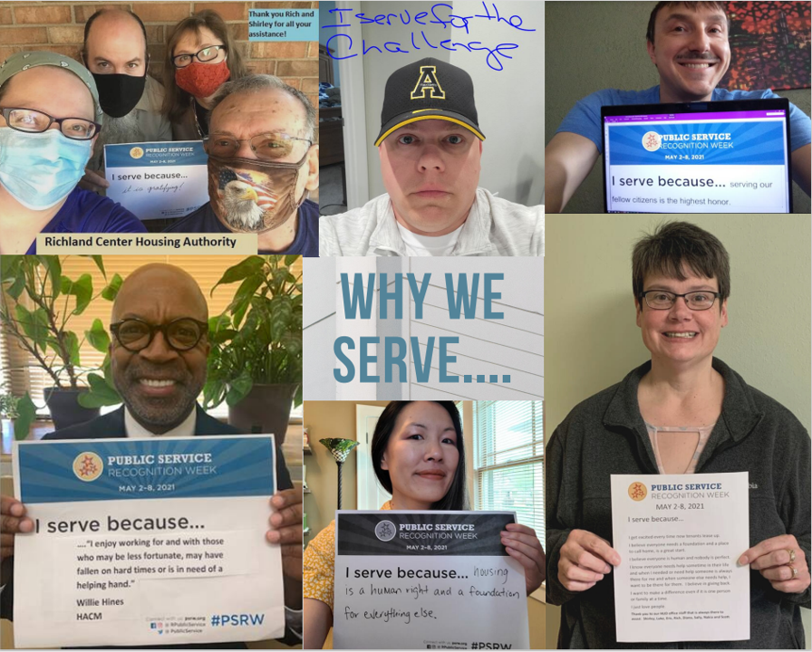

Slide 4
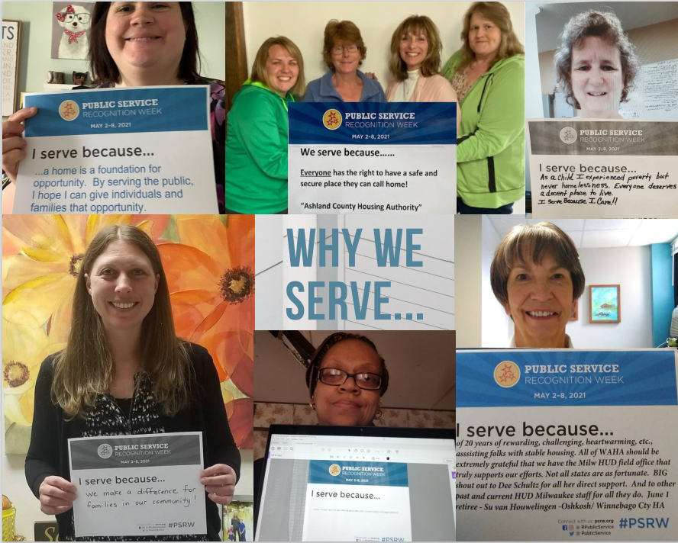

Slide 5
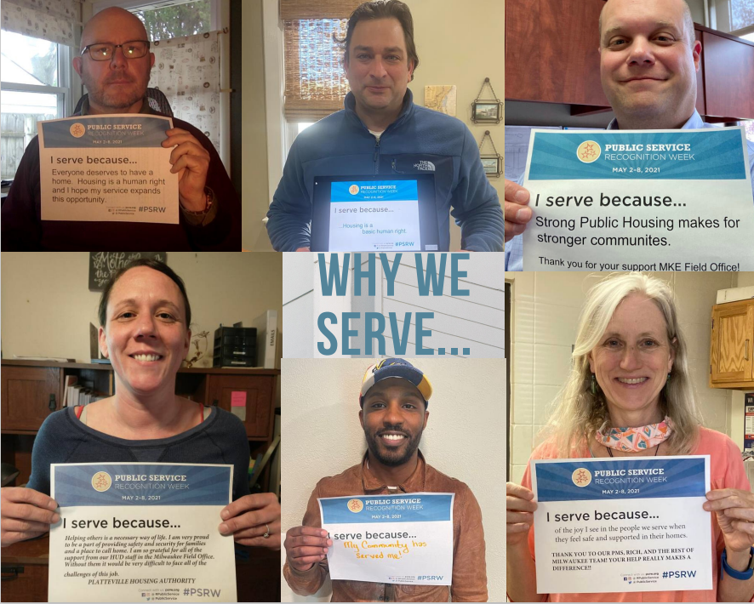

Slide 6
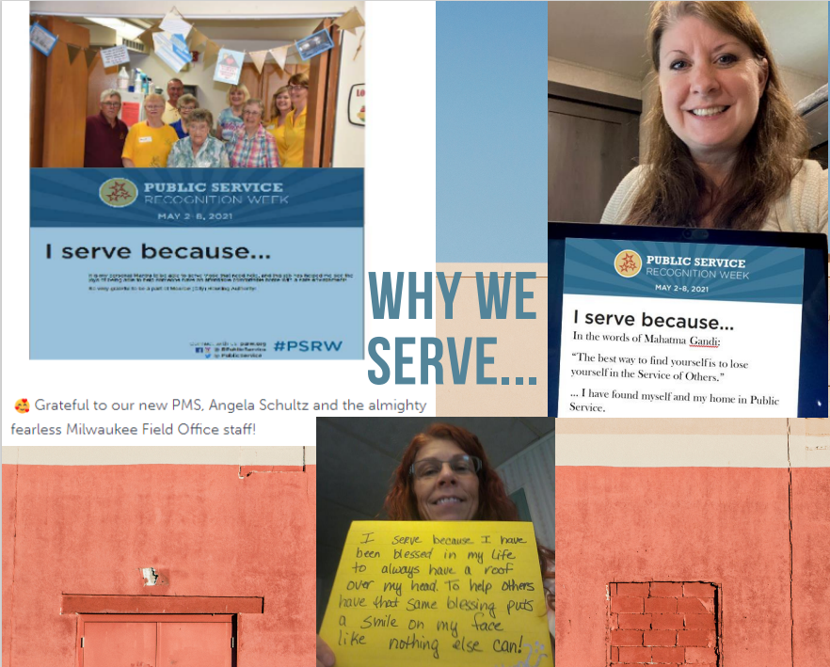

Slide 7
10,281 families housed in Public Housing
26,015 families assisted through Housing Choice Vouchers
1,826 families assisted through Special Purpose Vouchers
THANK YOU for all that you do for
low-income families in Wisconsin!

