Slide 1
Housing Choice Voucher Updates
John Finger, Program Center Coordinator
Anne Steffel, Financial Analyst
DeAnna Alfonso, Construction Analyst
Scott Koegler, Portfolio Management Specialist

Slide 2
THANK YOU!
WI PHAs continue to do a great job of administering your programs in a difficult financial and regulated environment.
All field office staff appreciate the continued dedication and efforts to provide affordable housing in WI.

Slide 3
HCV Utilization

Slide 4
HCV Cash Management
Intent of Cash Management Procedures:
Mitigate PHA accumulation of NRA funds
Reduce Treasury outlays and costs by timing the disbursements based on actual need
Facilitate a more efficient and timely method by which to account for PHA program reserves.
Each month’s HAP disbursement is based on the most recent quarter’s validated VMS monthly average HAP costs with 3% margin

Slide 5
HCV Cash Management
Initial Funding Letter – Line 25 is total funding for HAP - This is what utilization calculations are based on.
HUD Held Reserve (HHR) are HAP funding & must be included in funding available for utilization projections
Request HHR from your FMC representative

Slide 6
HHR
Total HAP Funds

Slide 7
HCV Cash Management
Because of the way PHAs are funded, monitoring your utilization of units and funding has become more important than ever.
How many units can your HCV program support?
Calculate your HAP per unit cost
Based on your HAP per unit costs, calculate how many units you can lease up based on your current funding

Slide 8
Two Year Tool
Key to Stable Operations!
Two-Year Tool can assist the PHA in determining how many units to lease up given the HAP funding and disbursements
Two Year Tool allows PHAs to conduct scenario testing on how various changes will affect the program
PUC changes
Proration
Increased / Reduced Leasing
Notes:
The key to stability:
Projecting into year two (and three)
Testing funding scenarios
Estimating year 2 funding
Testing issuance and leasing scenarios
Focusing on key variables

Slide 9
Variable Factors Impacting PHA
Need to Master Estimating Variables
Historic experience
Tracking and Trending
Critical Variables:
Success Rate of Issued Vouchers
Average time from issuance to HAP Contract
Turnover / Attrition / EOP
Per Unit Cost

Slide 10
Success Rate
% of vouchers issued that are leased
Policy Decisions Impacting Success Rate
Payment Standards
Voucher Expiration Date
Performance Impacting Success Rate
Landlord Outreach
Rent Reasonableness
Quality briefings
RFTA Processing – Prompt Inspections
Customer Service for both LL and Participant
Notes:
Can be the single biggest factor impacting utilization

Slide 11
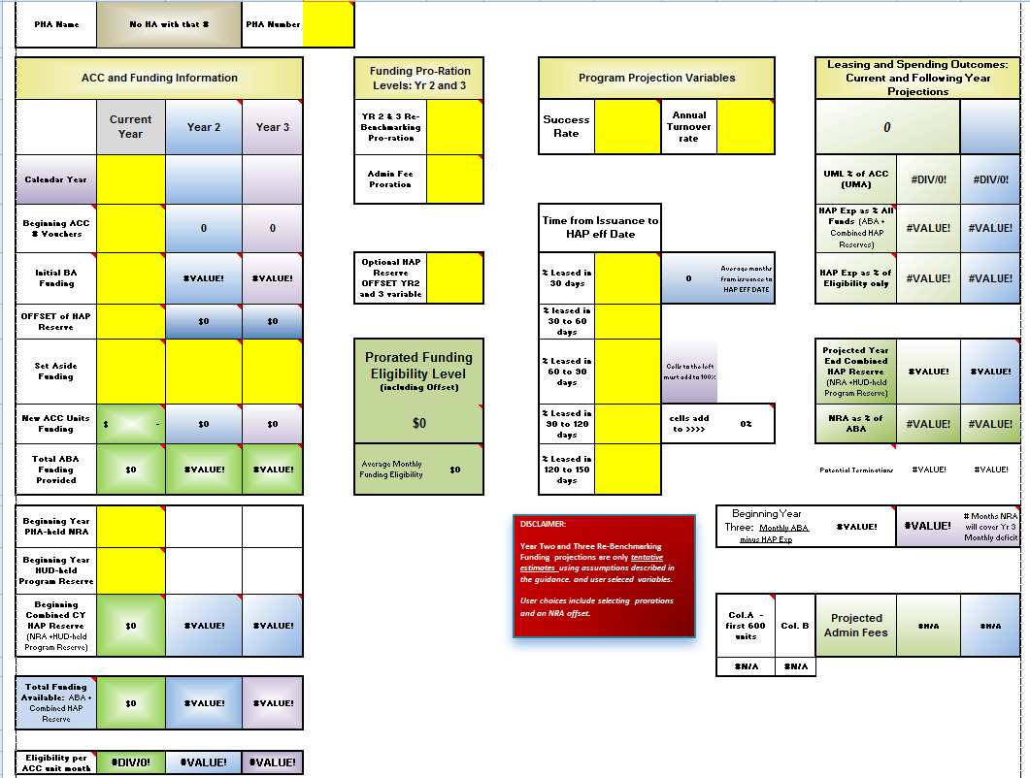
2 Year Tool

Slide 12
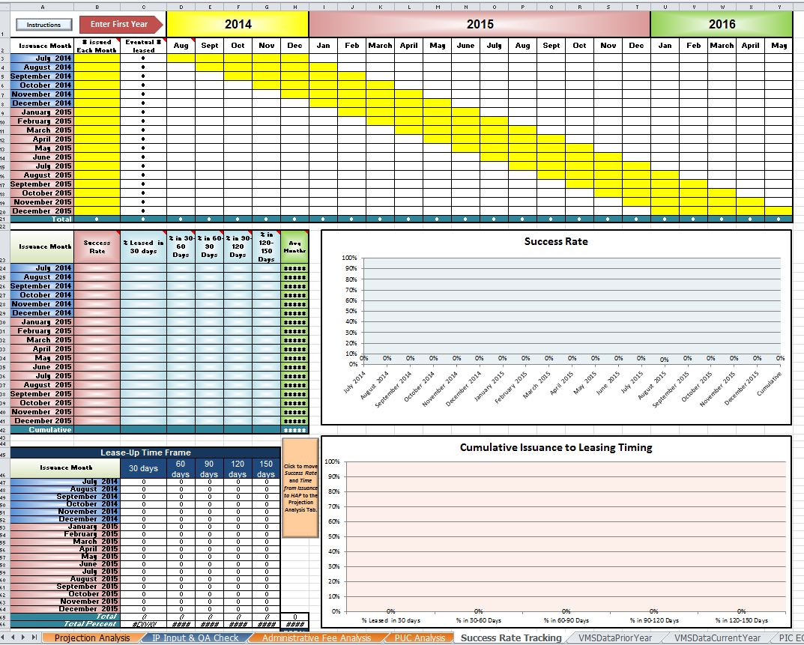
Success Rate Tracking

Slide 13
Attrition
Good Turnover vs. Bad Turnover
Trend and Comparison – Using PIC
Comparison – EOP Report
Trend – Viewer Report Page by Type Code

Slide 14
Project Based Vouchers
24 CFR 983
PHA discretion to operate PBV
No special funding – funding from annual HAP allocation (except VASH & RAD)
Cannot exceed 20% of budget authority
Policy for PBV must be in PHA Plan PRIOR to implementing a PBV program

Slide 15
Project Based Vouchers
PIH Notice 2015-05 Project Base Voucher Guidance
Timely Reporting of PBV on HUD 50058
Calculation of 20% Budget Authority Cap
PBV at PHA owned units
IMPORTANT – the requirements for PBV haven’t changed, only the process

Slide 16
Project Based Voucher Coming Attractions
New process to request verification of 20% of budget authority cap
At least 14 days prior to RFP must submit to HQS with copy to Field Office Director
HUD is developing a protocol to review completion of required steps for PBV
Checklist to document PHA compliance with PBV process

Slide 17
Homeless at Admission Reporting
Must determine whether family was homeless for ALL new admissions
Must be reported at question 4c on HUD Form 50058
Definition of homeless found in PIH Notice 2013-15
PHA may adopt narrower definition for waiting list preference but must still use 2013-15 definition for question 4c

Slide 18
HCV Streamlining Portability Final Rule
Effective September 21, 2015
Final Portability Rule and Side-by-Side comparison at: http://portal.hud.gov/hudportal/HUD?src=/program_offices/public_indian_housing/programs/hcv
Webcast at: https://www.youtube.com/watch?v=7M4Xn5XV-W8

Slide 19
Portability – What’s New
Family Briefing Requirements
Processing Family Moves
Voucher Term
Billing and Administration
Mandatory Absorption is NOT in final rule

Slide 20
Family Briefing
An explanation of the advantages of areas with low concentrations of low income
Requires PHAs to ensure that the list of landlords or other resources covers areas outside of poverty or minority concentration
An explanation of how portability works.
information on how portability may affect the family’s assistance and any other elements of the portability process which may affect the family’s assistance.

Slide 21
Processing Family Moves
PHA policies on family moves must be consistent with civil rights laws and regulations
HUD field office must be notified within 10 business days when denying portability due to insufficient funding

Slide 22
Voucher Term
PHAs suspend voucher term for all families (not just porting families) when:
Family submits RTA – suspension ends when PHA notifies in writing approval or disapproval
Receiving PHA voucher cannot expire before 30 days of initial voucher
Receiving PHA must notify initial PHA if granting any extensions

Slide 23
Billing and Administration
Requires use of email or other delivery confirmation methods (HUD recommends email)
Receiving PHA cannot refuse to assist portability family
Families choose the receiving PHA when more than one PHA in jurisdiction
If receiving PHA notifies it will absorb voucher cannot reverse decision without initial PHA consent

Slide 24
Billing & Admin Cont.
Receiving PHA policies are used in administration of voucher
Initial PHA must reimburse the receiving PHA for the lesser of 80% of the initial PHA’s administrative fee or 100% of the receiving PHA’s administrative fee

Slide 25
Proposed FY 2016 FMR
Federal Register September 8, 2015
Comments due by October 8, 2015
Current 50th Percentile FMR calculations still in place for FY2016
June 2, 2015 proposed rule to use Small Area FMR calculations – comments were due by July 2, 2015
http://www.huduser.org/portal/datasets/fmr.html
Notes:
small area FMRs (SAFMRs) for the HCV program within certain metropolitan areas. to provide HCV tenants with subsidies that better reflect the localized rental market, including subsidies that would be relatively higher if they move into areas that potentially have better access to jobs, transportation, services, and educational opportunities Small areas FMRs vary by ZIP code and support a greater range of payment standards than can be achieved under existing regulations.

Slide 26
Lead the Way Training
Training Modules available on HUD Exchange
FREE Self-paced internet based training
Addresses 6 Key Aspects of PHAs
Developed as training for PHA boards – but can be beneficial to all involved with PHAs
Notes:
Need to sign up for account on HUD exchange
The first three sections cover PHA foundations:
Fundamentals of Oversight presents the history and context of public housing.
Roles and Responsibilities addresses PHA board and staff functions.
Public Housing Basics outlines key components of public housing.
Lead the Way then helps enhance skills in six key aspects of PHA governance and financial management:
Asset Management
Housing Choice Voucher Program
Budgets
Ethics
Assessing Your PHA
Know Your PHA
Video vignettes, audio case studies, interactive worksheets, and online quizzes reinforce learning using real PHA staff and settings. And it is always at your fingertips by computer, tablet, or smartphone

Slide 27
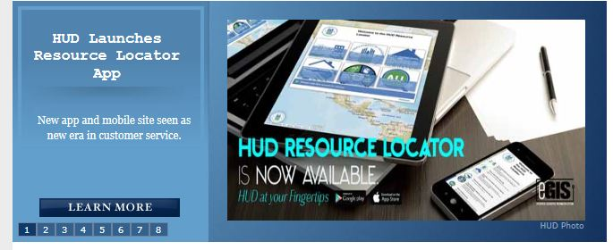
HUD Resource Locator
Available on Desktop, Tablet and mobile platforms

