Slide 1


Rental Assistance
Demonstration (RAD)
Final Notice Overview
December 2012

Slide 2

CURRENT CHALLENGES
Public Housing
Capital repair needs in excess of $25.6B across portfolio, or
$23,365/unit
Section 9 funding platform unreliable (pro-rations, cuts), inhibits access to private debt and equity capital (declaration of trust)
Losing 10,000-15,000 hard units/year
Section 8 Moderate Rehabilitation (Mod Rehab)
Cannot renew on terms needed to secure financing
Rent Supplement (Rent Supp) & Rental Assistance Payment (RAP)
No option to renew when contracts expire

Slide 3

LEGISLATIVE HISTORY
February 2010: FY11 Budget requests $350M for Transforming
Rental Assistance (TRA) initiative
May 2010: “Preservation, Enhancement, and Transformation of
Rental Assistance Act of 2010” (PETRA) - Administration’s bill
December 2010: “Rental Housing Revitalization Act” (RHRA) introduced by Rep. Ellison and co-sponsors
February 2011: FY12 Budget requests $200M for a “Rental
Assistance Demonstration” (RAD)
August 2011: RAD language submitted as “Technical Drafting Service” (TDS) to Rep. Ellison, Rep. Bachus, and Sen. Shelby
November 2011: FY12 Appropriations minibus authorized RAD

Slide 4
KEY RAD GOALS
Build on the proven Section 8 platform
Leverage private capital to preserve assets
Offer residents greater choice and
mobility

Slide 5

RAD AUTHORITY
Authorized in Consolidated Further Continuing Appropriations
Act of 2012 (Public Law 112-55)
  Initial program rules outlined in PIH Notice 2012-18 (3/8/12)
    Over 100 comments received
    HUD’s response to public comments on RAD website
  Final program rules outlined in PIH Notice 2012-32 (7/26/12)
Allows public housing and certain at-risk multifamily legacy programs to convert to long-term Section 8 rental assistance
Two Components
  1st Component, Competitive: Public Housing & Mod Rehab
  2nd Component, Non-competitive: Mod Rehab, Rent Supp, &
RAP

Slide 6
RAD CONVERSION ELIGIBILITY
Public Housing
Mod Rehab
Rent Supp & RAP
1st Component: Competitive, 60,000 Units
2nd Component:
Non-Competitive, No-Cap
(subject to availability of TPVs)
PBRA
PBV
PBV

Slide 7

1ST COMPONENT
Public Housing & Mod Rehab
Can compete to convert assistance to:
  Project-Based Rental Assistance (PBRA) or
  Project-Based Vouchers (PBV)
Cap of 60,000 units (applications must be received by
9/30/2015)
Convert at current funding only
Choice-Mobility, with limited exemptions
Extensive waiver authority to facilitate conversion
Initial application period: September 24 – October 24, 2012

Slide 8
2ND COMPONENT
Mod Rehab, Rent Supp & RAP
Upon contract termination/expiration, convert Tenant Protection Vouchers (TPVs) to PBVs
No cap, but subject to availability of TPVs
Choice-Mobility requirement per PBV program rules
Limited waiver authority to facilitate conversion
Prospective conversion authority through 9/30/2013
Retroactive conversion authority back to 10/1/2006
(convert by 9/30/2013)

Slide 9
PUBLIC HOUSING CONVERSION RENT LEVELS
Sample Public Housing Conversion Per Unit Monthly (PUM)
$900
$800
$700
Operating Fund
$330
Housing Assistance Payment
$474
$600
At conversion, PHAs will convert funding to a Section 8 contract rent.
$500
Capital Fund
$144
$792
$400
$300
$200
Tenant Payment $318
Tenant Payment $318
$100
$-
Pre-Conversion
ACC
Post-Conversion
Section 8
9

Slide 10

KEY PROGRAM PROVISIONS: 1ST COMPONENT
Provision | Requirement
 | Public Housing | Mod Rehab
Application Pools | 4 Census Regions, by PHA size; 58,750 total units | 4 Census Regions, by Mod Rehab size; 1,250 total units
Application Ranking Factors | Capital Needs Green Building Choice-Mobility Priority Project | Same
Ownership/Control | Public or non-profit ownership or control, except to facilitate tax credits, or, in foreclosure, bankruptcy, termination for cause, wherein project disposed first to capable public entity, then other capable entities as determined by Secretary | N/A
Initial Contract Term | PBRA – 20 years PBV – 15 years (20 with approval of voucher agency) | Same
Initial Contract Rents | PBRA – Lower of a) current funding, or b) 120% of FMR (less utility allowance); except where current funding is below market, wherein rent is limited to 150% of FMR PBV – Lower of a) current funding, b) 110% of FMR (less utility allowance), or c) reasonable rent | Same

Slide 11

KEY PROGRAM PROVISIONS: 1ST COMPONENT
Continued
Provision | Requirement Public Housing Mod Rehab
Capital and Operating Funds | Can be used in financing structure |  |  | N/A
Contract Rent Adjustments | Annually via Operating Cost Adjustment Factor (OCAF) |  |  | Same
Contract Renewal | Secretary shall offer and PHA shall accept renewals of such terms as provided in PBV and PBRA programs |  |  | •PBRA – if owner requests, Secretary renews per MAHRA terms •PBV – per normal PBV rules (up to 15 years)
Use Agreement | Long-term use agreement extended with each contract renewal |  |  | N/A
Resident Choice-Mobility | PBRA – Required after 2 years with PHA option of 15% project cap and 1/3 voucher turnover cap; good-cause exemption for up to 10% of conversions PBV – Per normal PBV rules |  |  | Same
PBV Inventory Limitation | Exempt from 20% limitation |  |  | Same

Slide 12

KEY PROGRAM PROVISIONS: 1ST COMPONENT
Continued
Provision | Requirement
 | Public Housing | Mod Rehab
PBV Income Mixing | Raised to 50% per property | Same
PBV Competitive Selection of Owner Proposals | Waived | Same
PBRA Limitations on Distributions | Waived | N/A
No Rescreening at Conversion | Required | Same
Resident Consultation | Required | Same
Recognition of Legitimate Resident Organizations | Required | Required for PBRA
Resident Participation Funding | Continued at $25 per occupied unit annually | N/A
Resident Procedural Rights under Section 6 of 1937 Act | As conveyed under Section 6 of 1937 Housing Act | N/A
Davis Bacon Act and Section 3 | Required for initial repairs | N/A

Slide 13

KEY PROGRAM PROVISIONS: 2ND COMPONENT
Mod Rehab, Rent Supp, & RAP
Provision | Requirement
Initial Contract Term | 15 years
Initial Contract Rents | Per normal PBV rules
Contract Rent Adjustments | Annually per normal PBV rules
Contract Renewal | Per normal PBV rules (up to 15 years)
Resident Choice-Mobility | Per normal PBV rules
PBV Inventory Limitation | Exempt from 20% limitation
PBV Income Mixing | Raised to 50% per property
PBV Competitive Selection of Owner Proposals | Waived
Resident Consultation | Required

Slide 14

PUBLIC HOUSING RESIDENT PROVISIONS
Resident Notification Prior to and During Conversion
No Rescreening of Residents at Conversion
One-for-One Replacement
  Must convert all or substantially all units in covered project
Family Self-Sufficiency (FSS) & Resident Opportunities and Self- Sufficiency (ROSS)
  FSS & ROSS participants may continue in programs
Resident Participation & Funding
  PHAs must recognize legitimate tenant organizations
  PHAs must provide $25 per occupied unit annually for resident participation per current Public Housing program rules
Resident Procedural Rights
  Consistent with Section 6 of the 1937 Housing Act

Slide 15
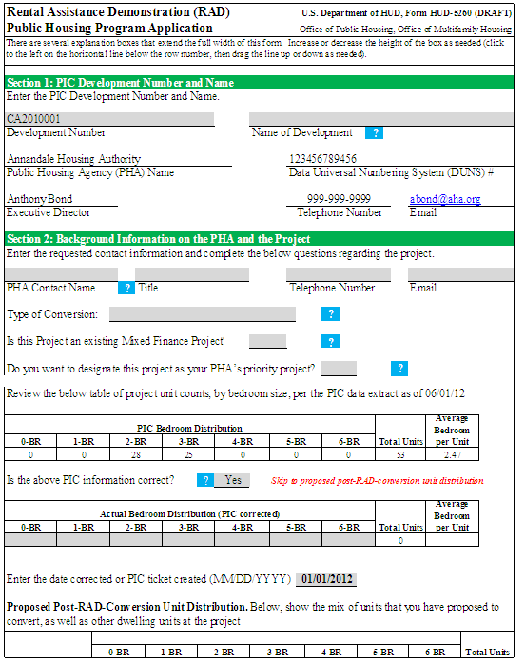
APPLICATION SNAPSHOT
Under the 1st Component, PHAs and owners will complete an Excel-based application, a draft of which is posted on the RAD website.

Slide 16
KEY DATES
1st Component (Public Housing & Mod Rehab)
Initial Application Window Opens
Initial Application Window Closes
Public Housing Ongoing Application Window Opens
Initial CHAP Awards
9/24/2012
10/24/2012
10/25/2012
12/2012
2nd Component (Mod Rehab, Rent Supp, & RAP) Rent Supp & RAP Requests for Conversions under Interim Authority
Rent Supp, RAP, & Mod Rehab Requests for Conversions under Final Notice
3/8/2012
7/26/2012
16

Slide 17
RAD WEB PAGE
RAD Notice, application materials, and
additional resources can be found at
www.hud.gov/rad
Email questions to rad@hud.gov
17

