Slide 1
RAD – Results Not Rules
WAHA Conference
September 17, 2013
Presented by:
C. Ray Baker & Associates

Slide 2
Is RAD for You?
My objective is to:
Be honest with you
Give you the information to decide:
About RAD
Which Site
Give you the tools to succeed
Help you avoid mistakes

Slide 3
Is RAD for You?
Be honest with yourself
Do your homework
Consider pooled procurements and transactions
Assemble the best possible team
Stay involved – follow the program

Slide 4
RAD vs. HOPE VI
In nine months there are more Public Housing Authorities and Public Housing Units committed to RAD than there were in the first two years of the HOPE VI program.
The RAD program has not required any additional funding from Congress.
Over 20 years Congress has spent $5.6 Billion on HOPE VI.

Slide 5
RAD Basics
What is RAD? HUD demonstration program that combines public housing operating and capital subsidy into payments under a Section 8 HAP contract
What kinds of developments are being done with RAD? Minor rehab; major rehab; new construction; mixed income; off-site replacement housing
How do I determine if I have a project/portfolio that would be a good candidate for RAD conversion? Use the RAD Inventory Assessment Tool in the Resources section of www.hud.gov/rad
How would RAD affect:
Residents: No change; 30% of income for rent
PHA Functions: Dependent on cash flow, fees, strong management; puts them on the more secure Section 8 funding platform; Gives them the affordable housing tools of other nonprofit developers
Resources: www.hud.gov/rad; www.radcapitalmarketplace.com; www.radresource.net

Slide 6
RAD Basics
Contract Rents:
Operating Fund (with Operating Fund Allocation Adjustment)
+ Capital Fund
+ Tenant Rents
= RAD Contract Rent
Can convert Public Housing to:
Project-Based Rental Assistance (PBRA) or
Project-Based Vouchers (PBV)
Can only convert at current funding levels
WHY IS THE SECTION 8 FUNDING MODEL MORE SECURE FOR A PHA?
Tenant Protections:
Tenants have the absolute right to return
Choice-Mobility, with limited exemptions
Extensive waiver authority available to facilitate conversion

Slide 7
Public Housing Conversion Rent Levels
ACC
Section 8

Slide 8
Where’s The Money?
The RAD options:
Modest rehab with debt only
Moderate rehab with debt and 4% LIHTCs
Major rehab or replacement with debt and 9% LIHTCs
These are funding sources that are not conveniently available to small PHAs
A conversion of all LIPH units eliminates the HUD requirements for:
Procurement
Annual and Five- Year Plans
PHAS
REAC (if…)
You Get to Keep the Money

Slide 9
The RAD Details
Ownership – Public or non-profit, except to facilitate tax credits
The authority leases the land to the LIHTC Partnership
A Physical Condition Assessment (PCA) must be performed on RAD sites to determine the improvements required
The authority must comply with the Uniform Relocation Act
An existing PILOT agreement must be renewed when ownership changes
Davis-Bacon wages must be paid during rehabilitation

Slide 10
Key Changes in the RAD Notice
Mixed Finance projects
Removes unit cap for Mixed Finance projects
Allows financially distressed HOPE VI projects to apply
Exempts awarded projects from the Public Housing Assessment System (PHAS)
Extends Capital Fund obligation and expenditure deadlines
Clarifies conditions for “rehab assistance payments”
Notes:
HUD will honor the FY 2012 RAD contract rents for all applications received before end of CY 2013 (applies to individual applications, portfolio awards, and multi-phase awards)
PHA may adjust Contract Rents across multiple projects as long as aggregate subsidy does not exceed current funding (“rent bundling”)

Slide 11
Key Changes in the RAD Notice
Eliminates caps on units that can convert for:
Public housing
Mode Rehab
Creates new awards for:
Portfolio conversions
PHA defines “portfolio” of projects, either the entire PHA inventory or some subset
PHA must submit applications for at least half of the projects in portfolio
HUD will reserve award for remaining units in portfolio
PHA must submit application for remaining projects in portfolio within 365 days
Multi-phase conversion
Allows PHAs to reserve conversion authority for projects with multiple development phases with applicable contract rent for all phases
PHA has until July 1, 2015 to submit application for final phase
PHA required to fulfill all CHAP milestones for each CHAP awarded
Upon application acceptance, HUD will issue CHAP for initial phase and multi-phase award letter covering all phases of project
Joint RAD/CNI applicants

Slide 12
Why RAD?
What Makes RAD So Special?
One simple application, not four long ones.
Not competitive, just get it right.
Rapid turnaround by HUD.
Less procurement, fewer specialized consultants.
High probability of approval. How high?
RAD brings in new money.

Slide 13
The RAD Process
What Makes RAD So Special?
Board Approval
Site Selection
Tenant Meetings
Non-binding letters from lenders and LIHTC investors
Submit the application
Can the Authority stop the RAD process?

Slide 14
Conversion Steps – Public Housing
HUD Publishes Final Notice
PHAs submits Excel-based Application to HQ
HQ reviews application and requests Field Office input on Eligibility
HQ issues awards/Commitments to Enter Housing Assistance Payments Contract (CHAPs)
PHAs have 6 months to submit Financing Plan to HQ for review
PHA
Asset Management
Subsidy
Administration
PBV
PIH
Voucher Oversight
Project converts
Remove from ACC
Release DOT
Execute HAP
Execute RAD Use
Agreement
Close Financing
HUD issues RAD Conversion Commitment
Multifamily Housing
Asset Management
Subsidy
Administration
PBRA

Slide 15
The application
Simple, start with basic pro forma www.hud.gov/rad
Application
Two resident meetings
Board meeting and approval
Financing letters
Lender
Investor
If 9% credit, letter from HFA or self-scoring
Choice Mobility: Letter for PBRA; ability to administer for PBV
If converting a project that is currently mixed-finance, need signatures of all parties
Fix “Fatal Error” issues
CHAP Award

Slide 16
Closing Process - Milestones
Post CHAP
DAY 1: CHAP Issued; Transaction Manager assigned
DAY 30: Information on Development Team
(“One Round” allowance for LIHTC; schedule subject to oversight by TM)
DAY 60: Firm Financing Letters
DAY 180: Submit Financing Plan
DAY 360: Closing and Conversion; Section 8 begins to fund
Post Conversion
Temporary Relocation (if necessary)
Demolition (as necessary; no Section 18 approval required)
Rehabilitation or New Construction
Re-occupancy

Slide 17
Your Authority
What are your key decision points?
Which sites:
Least rehab
Most rehab
Debt Only?
LIHTCs:
4%
9%
PBRA or PBV?

Slide 18
Which Site First?
Do you select the site that:
Needs the most work
Can be converted with modest improvements
Can be converted with no improvements
If you do your RADomatic sites first what about PHAS
Please consider a Portfolio Application
Please consider Pooled Procurements
Lobby WHEDA

Slide 19
Ten things…
1. Contract Rents
Referred to as “current funding”
Amounts can be found in:
RAD Inventory Assessment Tool (rows 71-74 of the Inventory Overview Tab), and
RAD Application (rows 5-7 of the Validation Tab)
Based on 2012 funding levels:
2012 Tenant rents (from subsidy worksheet)
2012 Capital Fund Grant Award, by project
2012 Operating Subsidy Eligibility, assuming 95% proration (i.e., we restored the Operating Fund “Allocation Adjustment”), excluding Asset Repositioning Fee (a special fund for demo/dispo projects)
Current funding may be affected by PBV or PBRA rents caps, which are sensitive to estimated market (reasonable) rents
Inventory Assessment Tool estimates market rent by using typical voucher rents (93% of FMR)
RAD rents will be inflated beginning in 2014 using OCAFs (Operating Cost Adjustment Factors)
OCAFs apply for both PBRA and PBV

Slide 20
Ten things…
1. Contract Rents (cont.)
RAD contract rents reflect whatever utility arrangements are in effect at the project.
Project-paid utilities -- RAD rents equal Gross Rents
Tenant-paid utilities – RAD rents plus utility allowance equals Gross Rents
Inventory Assessment Tool uses average utility allowance (data was not available by bedroom size)
RAD rents reflect any existing Energy Performance Contracts (EPCs)
If project has an EPC where HUD has allowed a freezing of the project-paid consumption baseline, or an energy “add-on”, those arrangements will be carried over in RAD
During the remainder of the initial calendar year of funding, the project receives only what it would have received under the public housing program (i.e., it carries forward all remaining Operating and Capital Funds for that year)
If a PHA changes the bedroom distribution, the contract rents will be adjusted accordingly. Under public housing funding formulas, operating subsidies increase with each increase in average bedroom size (and decreases in each decrease in average bedroom size)
For partial conversions, just enter the proposed number of units, and bedroom mix, and both the Tool and Application will show the new contract rents

Slide 21
Ten things…
2. PBVs vs. PBRA
See accompanying chart of differences between PBV and PBRA
Election depends on many factors
3. Choice-Mobility
Applies to all conversions unless project has received an exemption
Exemption available to: (1) public-housing only PHAs, and (2) PHAs that currently provide a preference in their voucher programs for homeless and vets if such preferences account for more than 33% of voucher turnover.
Exemptions are granted based on first-come, first-served basis
Requirements:
PBV – first available voucher after one year
PBRA – first available voucher after two years; however, PHA may also limit Choice-Mobility to not more than 15% turnover in any year and not more than 33% of voucher turnover in any year
In all cases, assistance remains with the project. The mobility voucher comes from the agency’s voucher turnover

Slide 22
Ten things…
4. Right to Return and Relocation
All existing residents have a right to return to the RAD project, including Transfers of Assistance.
There is no RAD requirement to retain the same bedroom mix or building type; however, a PHA must still meet the right to return requirement when making changes in bedroom mixes
Residents may voluntarily waive their right to return – a PHA may offer, for example, a turnover voucher or a unit in public housing
To assist with relocation, HUD will make “Rehab Assistance Payments” for units under rehab or construction, equal to current subsidies, for all units receiving subsidy at the time of conversion.
As a result, HUD does not provide Tenant Protection Vouchers (TPVs) for RAD and all other relocation expenses must be addressed in the Development Budget
If relocation must last for more than one year, the family is considered to be permanently relocated under the Uniform Relocation Act (AC) and the PHA must find the family “comparable assisted housing”, which can include public housing or vouchers. While these resources will satisfy the URA, the family must still be given the right to return to fulfill RAD requirements (if not voluntarily waived)

Slide 23
Ten things…
5. De Minimis Reductions and Transfers of Assistance
PHA must replace 95% of all units at project converting, with exceptions for units vacant for more than two years, to facilitate social service delivery, or for reconfiguring efficiency apartments.
PHA can rehab, tear down on site and build new construction on or off-site
PHA can also acquire/transfer the assistance
Projects meeting RAD de minimis requirements do not need to seek separate approval from the Special Applications Center (SAC) to demolish or dispose of the project (exempt from so-called “Section 18”).
PHA may, however, apply to the SAC for demo/dispo for a portion of the project
All conversions must still meet right-to-return requirements

Slide 24
Ten things…
6. Public Housing Mixed-Finance Projects (i.e., projects developed under 24 CFR part 941, subpart F)
To convert to RAD, both the PHA and the mixed-finance ownership entity must agree
HUD will fund the project at the established RAD contract rent (or some other amount if the PHA is “bundling” projects); however, the PHA and ownership entity can decide how those funds are split (say, a new lease payment), provided the “deal” is considered feasible
There is no limit to the number of mixed-finance projects (other than HOPE VI projects) that can convert
The PHA and the ownership entity will need to “unwind” the mixed-finance project – (1) the Declaration of Restrictive Covenants, (2) mixed-finance ACC, and (3) the Regulatory and Operating (R&O) Agreement. HUD recommends that the R&O be replaced by a streamlined regulatory agreement.
Projects that are currently being developed under “Faircloth” may not be eligible for RAD if those projects are not currently receiving assistance under public housing (however, HUD is looking at the possibility of a “joint closing” process down the road)

Slide 25
Ten things…
7. Program Funds and “De-federalization”
There is no restriction on use of cash flow (and no residual receipts account), mortgage proceeds, or developer fees – PHAs are bound only by State and local laws, as applicable
Unless the project is the remaining project to convert in a PHA’s inventory, there will be a subsidy layering review where the PHA contributes Capital Funds to the Development Budget or where the PHA contributes public housing operating reserves in excess of the three-year average of reserves for the project
All proceeds from seller-take back financing related to LIHTC transactions is also de-federalized.
8. Public Housing-only PHAs
If convert to PBV, must find a voucher administrator willing to administer the PBV contract (that voucher agency will earn new admin fees)
If convert to PBRA, will need to request Choice-Mobility exemption (or otherwise find a voucher agency willing to provide Choice-Mobility)

Slide 26
Ten things…
9. Projecting Operating Costs
If estimating Operating Costs as a percentage of current Formula Expenses (say, 95%), keep in mind that “Formula Expenses”, as defined, within the Inventory Assessment Tool, exclude funding the PHA may receive under Stop-Loss (called “Transition Funding”)
If estimating Operating Costs based on historical project expenses, remember that HUD’s public housing financial reporting model (1) has a slightly different chart of accounts than FHA and (2) has a separate column for Operating Fund and one for Capital Fund. Generally, you will want to include only the Operating Fund column
10. Resident Participation
Remember to include two meetings with residents of the project prior to submitting an application (a PHA can combine more than one project at each meeting, as long as residents are notified accordingly)
Remember to have one meeting with residents after RAD award (and prior to submission of Financing Plan)
The PHA will also be required to submit a Significant Amendment to its Annual Plan, which also has public notice requirements

Slide 27
Ten things…
11. Bonus – RAD Physical Condition Assessment (RPCA)
Required only after CHAP award
Exclusions for: new construction, for rehab that is “down to the stud”, and for projects recently built (based on HUD approval)
HUD shortly to form “user group”
12. Bonus – Ownership Type
Ownership can include:
PHA, directly or through related non-profit
Any other public or non-profit owner
For-profit owner in the case of tax credits
No approval required of these alternate ownership arrangements (other than 2530/APPS process)

Slide 28
Various Considerations in Choosing PBRA vs. PBV
Item | PBRA | PBV
1. Baseline Funding Levels | Based on 2012 levels, with Operating Fund Allocation Adjustment restored | Same
2. Initial Contract Term | 20 years | 15 years (up to 20 at option of voucher agency); voucher agency may also automatically extend for another 15 years
3. Contract Renewals | At end of contract term, Secretary must offer, and PHA must, accept renewal | Same
4. Rent Caps | Current funding cannot exceed 120% of the FMR, unless the current funding is less than market, in which case the current funding cannot exceed 150% of FMR. | Current funding cannot exceed the lower of (1) reasonable rent or (2) 110% of FMR.
5. Annual Inflation Adjustment | Based on Operating Cost Adjustment Factor (OCAF), i.e., the method used to adjust rents for Multifamily projects renewed under the Multifamily Assisted Housing Reform and Affordability Act (MAHRAA). | Same
6. Choice Mobility | Resident may request next available voucher after two years; however, voucher agency may limit to not more than 15% of project in any year and not more than 33% of voucher turnover due to RAD. | Resident may request next available voucher after one year, with no limitations.
7. Voucher Admin Fee | N/A | PHA earns Section 8 voucher admin fee for all units converted to PBV. Note: for agencies that do not administer a voucher program, and that convert to PBVs, the voucher agency will be responsible for administration of the waiting list, eligibility, reexaminations, leading to substantial deregulation for the converting agency.

Slide 29
Various Considerations in Choosing PBRA vs. PBV
8. REAC/UPCS Inspections | Yes | No (unless project receives FHA insurance)
9. REAC/FASS-MF Annual Financial Statements | Yes | No (unless project receives FHA insurance)
10. Management and Occupancy Reviews (MORs) | Yes | No (unless project receives FHA insurance)
11. Cash Flow | Unrestricted | Same
12. Appropriations | Annual funding subject to appropriations; however, the Congress has never failed to renew a PBRA contract | Annual funding subject to appropriations. Because of the RAD Use Agreement, if Congress provides less than full funding for the Voucher program (i.e., proration), the PHA administering the voucher program may will likely need to absorb the cuts from its non-RAD voucher units.
13. Rehab Requirements | There is no required level of rehab under RAD (or requirement to leverage debt). The PHA must simply ensure that whatever needs are identified are addressed. | Same
14. FHEO Site/Neighborhood Standards | Standard FHEO requirements not waived under RAD. | Same
15. Income Mixing | N/A | Under normal PBV rules, not more than 25% of units in a project can be assisted, unless the units are elderly or disable, scattered site, or receiving supportive services. RAD increased the threshold to 50%, with the same exceptions. (see pages 30-41 PIH 2013-32 –REV. 1)

Slide 30
PUBLIC HOUSING CONVERSIONS
Resident Provisions
No Re-Screening of Residents at Conversion
One-for-One Replacement Must convert all or substantially all units in covered project
Family Self Sufficiency Current FSS participants continue in program
Resident Participation & Funding PHA must recognize legitimate tenant organizations PHA must provide $25 per occupied unit annually for resident participation ($15 per occupied unit > legitimate tenant organization
Resident Procedural Rights Consistent with Section 6 of the 1937 Housing Act
Resident Relocation Consistent with Uniform Relocation Act

Slide 31
Wisconsin PHAs
1 | RACINE COUNTY HA | 8
2 | LUCK HA | 16
3 | EAU CLAIRE COUNTY HA | 16
4 | GREENWOOD HA | 20
5 | PULASKI CDA | 20
6 | Lincoln County HA | 20
7 | Brillion HA | 24
8 | WOODVILLE HA | 26
9 | MONDOVI HA | 26
10 | REEDSVILLE HA | 27
11 | CUMBERLAND HA | 27
12 | TOMAH HA | 28
13 | LAFAYETTE COUNTY HA | 28
14 | GRANTSBURG HA | 29
15 | Barron HA | 30
16 | Abbotsford HA | 30
17 | Chetek HA | 30
18 | SHELL LAKE HA | 30
19 | OSCEOLA HA | 30
20 | ALBANY HA | 32
21 | Burnett County HA | 32
22 | PARK FALLS HA | 35
23 | WESTBY HA | 35
24 | ALTOONA HA | 36
25 | WASHBURN HA | 36
26 | DEFOREST HA | 36
27 | ALGOMA HA | 39
28 | SPOONER HA | 40
29 | NEW RICHMOND HA | 40
30 | PRAIRIE DU CHIEN HA | 40
31 | SAUK CITY HA | 40
32 | LADYSMITH HA | 40
33 | PESHTIGO HA | 40
34 | SAUK COUNTY HA | 40
35 | ASHLAND COUNTY HA | 40
36 | FOND DU LAC HA | 43
37 | CHILTON HA | 44
38 | BRUCE HA | 45
39 | Boscobel HA | 46
40 | SLINGER HA | 49
41 | STANLEY HA | 50
42 | PLYMOUTH HA | 50
43 | MAUSTON HA | 50
44 | RHINELANDER HA | 50
45 | BARABOO CDA | 50
46 | AMERY HA | 51
47 | HUDSON HA | 51
48 | FREDERIC HA | 53
49 | HURLEY HA | 54
50 | SPARTA HA | 58
51 | SOUTH MILWAUKEE HA | 60
52 | RICHLAND CENTER HA | 60
53 | THORP HA | 60
54 | TREMPEALEAU HA | 60
55 | CLINTONVILLE HA | 61
56 | JEFFERSON HA | 62
57 | LAKE MILLS HA | 63
58 | NEW LONDON HA | 63
59 | WAUSAUKEE HA | 65
60 | KAUKAUNA HA | 71
61 | RIVER FALLS HA | 71
62 | WEST BEND HA | 73
63 | OCONTO HA | 75
64 | MARINETTE HA | 76
65 | WATERTOWN HA | 80
66 | ANTIGO HA | 85
67 | MONROE HA | 86
68 | Winnebago HA | 86
69 | DANE COUNTY HA | 86
70 | DEPERE HA | 100
71 | MERRILL HA | 102
72 | MANITOWOC HA | 102
73 | EDGERTON HA | 105
74 | EAU CLAIR HA | 111
75 | MENOMONIE HA | 123
76 | LACROSSE HA | 128
77 | RICE LAKE HA | 129
78 | VIROQUA HA | 130
79 | BELOIT HA | 131
80 | SHAWANO HA | 146
81 | ASHLAND HA | 169
82 | WISCONSIN RAPIDS HA | 195
83 | SHAWANO COUNTY HA | 202
84 | GREEN BAY HA | 204
85 | MARSHFIELD HA | 209
86 | Appleton HA | 210
87 | SHEBOYGAN HA | 240
88 | FOND DU LAC HA | 249
89 | STEVENS POINT HA | 253
90 | WAUKESHA HA | 264

Slide 32
Wisconsin PHAs
91 | WAUSAU HA | 344
92 | Oshkosh HA | 410
93 | Superior HA | 465
94 | LA CROSSE HA | 593
95 | MADISON HA | 743
96 | MILWAUKEE HA | 3874

Slide 33
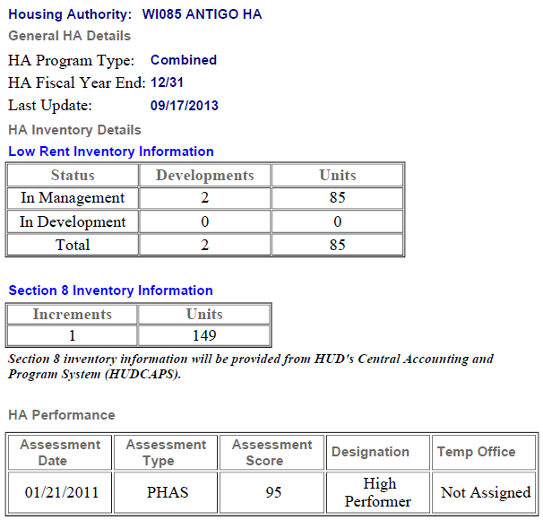
Your Authority

Slide 34
Your Authority
WI085000002 OPFund Antigo Housing Authority $105,681
2002 CF $106 266
2012 CF $ 74,993
Decrease $ 31,273 29.4%

Slide 35
Your Authority
Langlade County FMR

Slide 36
Is Your Site In A QCT?
http://209.48.228.153/qctmap.html

Slide 37
Public Housing Resources & Tools
Determining a PHA’s RAD Rent
www.hud.gov/rad
“Resources”
PHA Conversion Guide
RAD Inventory Assessment Tool
Fill in PHA #
Populate
Fill in basic financing assumptions
Top rent in BOLD is RAD rent
Feasibility with debt only
Feasibility with 4% LIHTC & 9% LIHTC

Slide 38
The RAD Inventory Assessment Tool

Slide 39
The RAD Inventory Assessment Tool

Slide 40
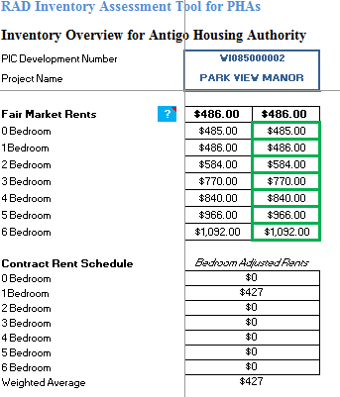
The RAD Inventory Assessment Tool

Slide 41
FHA Multifamily Mortgage Insurance
Section 223(f)
Refinance or acquisition
Minor/moderate repairs ($6,500/unit*high cost factor)
Permanent debt with repair escrow - up to 35 years
Section 221(d)(4)
Substantial rehab: 2 major building systems
Construction/permanent debt all in one - initial/final closing
40-year financing
Mortgagee Letter for RAD Transactions issued 10/12
Eligibility, underwriting criteria, processing & materials

Slide 42
FHA LIHTC Pilot Program
Streamlined-Enhanced FHA 223(f) & LIHTCs
Rehab expenditures of up to $40,000/unit
Tax credit or Bond Cap allocation in hand
Processed in Multifamily Hubs
Using MAP lenders approved for the Pilot
Goal of 3-4 month turnaround on applications

Slide 43
Federal Home Loan Bank AHP
Affordable Housing Program (AHP)
This program is funded with 10% of the Federal Home Loan Banks' net income each year.
Most effective when paired with other programs and funding sources, like Low-Income Housing Tax Credits.
More than 776,000 housing units have been built using AHP funds, including 475,000 units for very low-income residents.
$4.6 billion in total AHP dollars since 1990. That’s 200 million per year.
AHP loan funding often comes with an equal amount of grant funding.

Slide 44
RAD & LIHTCs
RAD Sweet Spot—Debt Only
Abt study—$24k/unit average capital need
Opex at $4,500 pupy + $300 replacement reserves
FHA debt at 3.45%; 1.2 DCR
Feasible with RAD rents above ~$610/month

Slide 45
RAD & LIHTCs
RAD Sweet Spot—4% LIHTCs
Rehab needs above $24k/unit to ~$40k/unit
Ease of meeting 50% test with RAD rents
Available P-A Volume Cap
Non-competitive
QAPs favoring preservation, green
Evolving, accessible short-bond structure
Historically low borrowing rates

Slide 46
RAD & LIHTCs
RAD Sweet Spot—9% LIHTCs
Targeted prospects for substantial rehab & replacement housing
No Section 18 review
Income mixing
Split project (AMP)
9% LIHTC used to help cover relo/demo/first phase
4% LIHTC for balance of site
RAD HAP contract(s) for off-site replacement
Acquisition/rehab
New construction

Slide 47
results of the competitive round
Initial Public Housing Awards
Total applications: 113
Total awarded public housing projects: 110
Total awarded PHAs: 68
Total awarded Public Housing Units: 11,910
PHA Size*
32% Small (<250 Units in Inventory)
52% Medium (251-1,249 Units in Inventory)
16% Large (1,250+ Units in Inventory)
*Based on 68 awarded PHAs

Slide 48
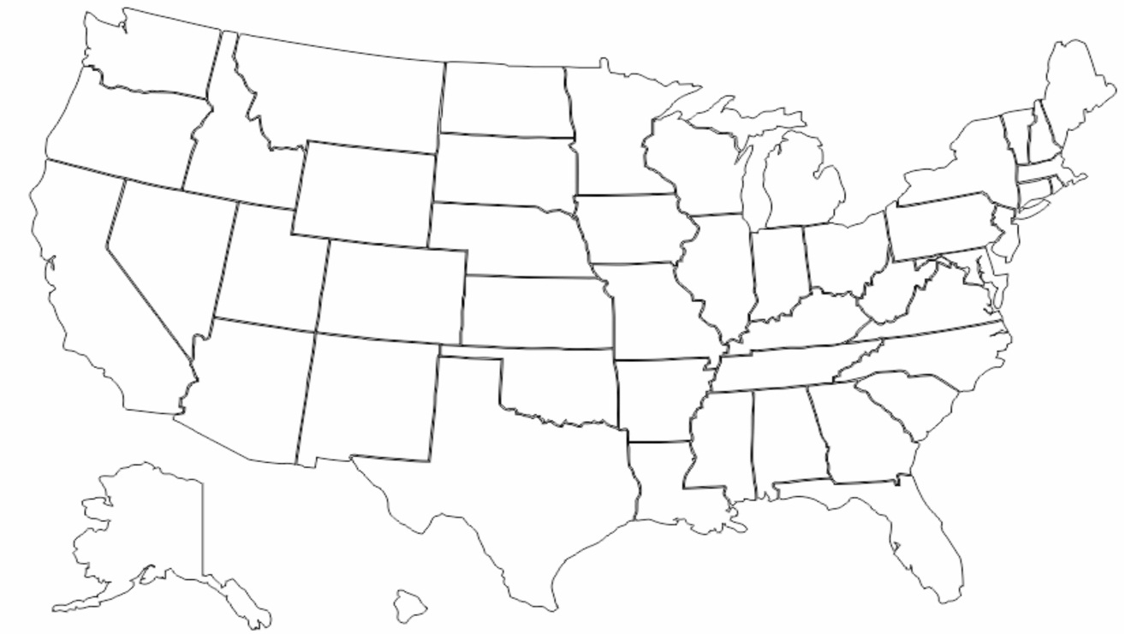
RAD Across the Country – 1st Component
 | Northeast | Midwest | South | West | Total
PHAs and Mod Rehab Units Awarded | 949 | 1,279 | 9,997 | 2,556 | 14,781
949
Units
1,279
Units
2,556
Units
9,997
Units

Slide 49
RAD Awards Trend Chart

Slide 50
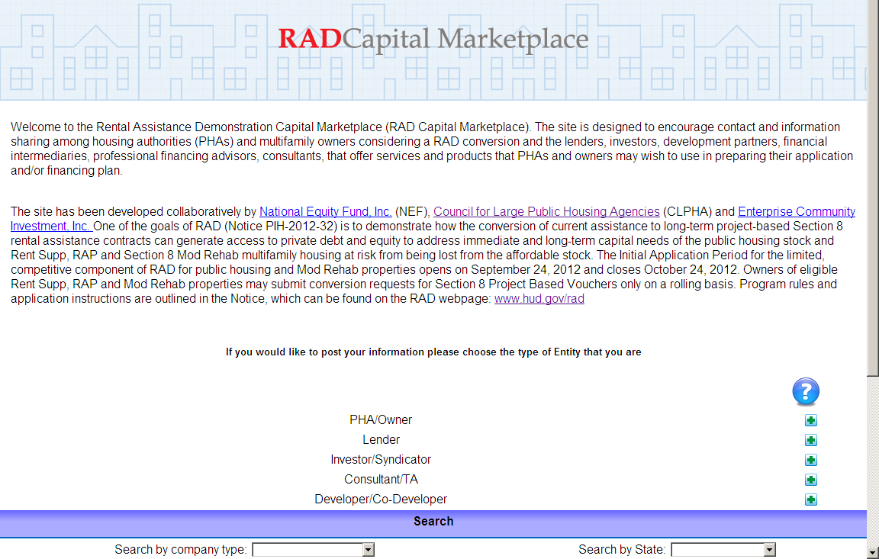
RAD Capital Marketplace
www.radcapitalmarketplace.com

Slide 51
RAD Web Page
RAD Notice, application materials, and additional resources can be found at
www.hud.gov/rad
Email questions to radresource.net

